Slide 2


DMU
Hacking Society
Spooky Linux

Slide 3





DMU HACKERS
D0nt d0 1ll3gal sh1t
please..

Slide 4
DMU HACKERS
Announcements
Hoodies/Q-Zips
BT Talk (Red Team) (Tues)
Airbus Day (18th)
Other Talks
Memberships
Gradcracker

Slide 5
DMU HACKERS
What is Linux?
Linux is an open-source operating system
Has different distributions - Debian, Arch, Kali
Kali is standard for penetration testing and digital forensics
over 600 pre-installed tools - Nmap, Metasploit, Wireshark, etc
Customisable
Easy to use

Slide 6
DMU HACKERS
Structure?
boot - contains boot loader
etc - contains system config files and directories
/etc/passwd - contains user info
/etc/shadow - stores encrypted passwords
dev - contains files relating too devices
mnt - location for temporarily mounting file systems
var - programs store runtime info
bin - contains executable files
tmp - temporary files - deleted when system restarts
home - contains the personal directories for users
root - home directory of the root user
proc - info on currently running processes

Slide 7
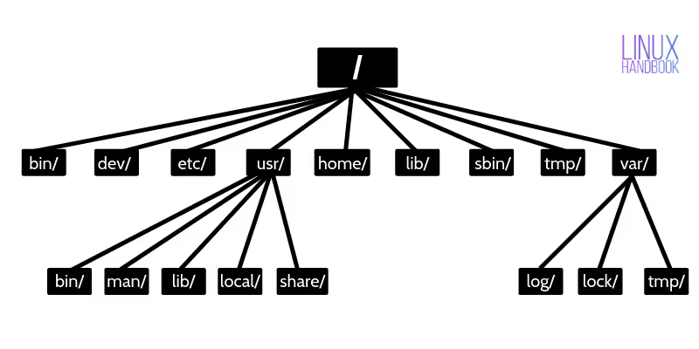
DMU HACKERS

Slide 8
DMU HACKERS
Commands
man - shows the manual for each command
--help - quick summary of command usage
Both will show the flags that can be used and what they are used for
Flags are options used to modify the command & fine-tunes the command - more precise
(-) for single-letter flags, (--) for long-form flags

Slide 9
DMU HACKERS
Commands
cd - change directory
pwd - print working directory
ls - lists contents of the current directory
cat <filename> - outputs the inputted files contents
cp - copy
rm - delete/remove
strings - find sequences of printable strings and prints them
mkdir - make a directory
touch - create an empty file
whoami - displays the username of the current user
id - displays info about the user id and user groups

Slide 10
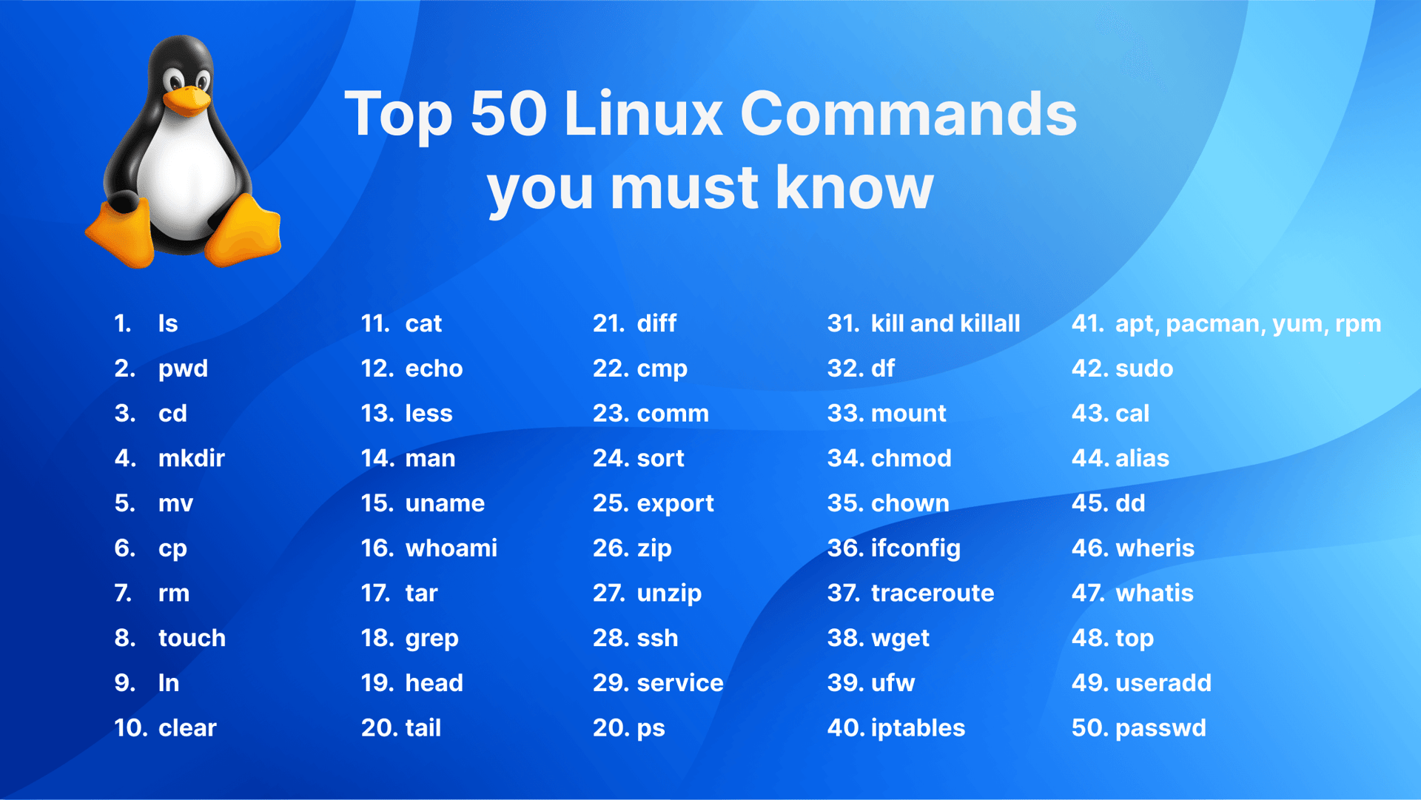
DMU HACKERS

Slide 11
DMU HACKERS
Commands
curl - transfers data to and from servers using URL
find - searches for files or directories based on conditions
grep <...> - searches for the given input in...
less - makes file outputs scrollable
head - displays the first lines of a file (as many as you choose)
tail - displays the last lines of a file (as many as you choose)

Slide 12
DMU HACKERS
CHanging Permissions
chmod - modify file permissions
600 for RSA Private Keys
r - read permissions,
w - write permissions,
x - execute permissions
read (4), write (2), execute (1)
chown - changes the user or group ownership of a file/directory

Slide 13
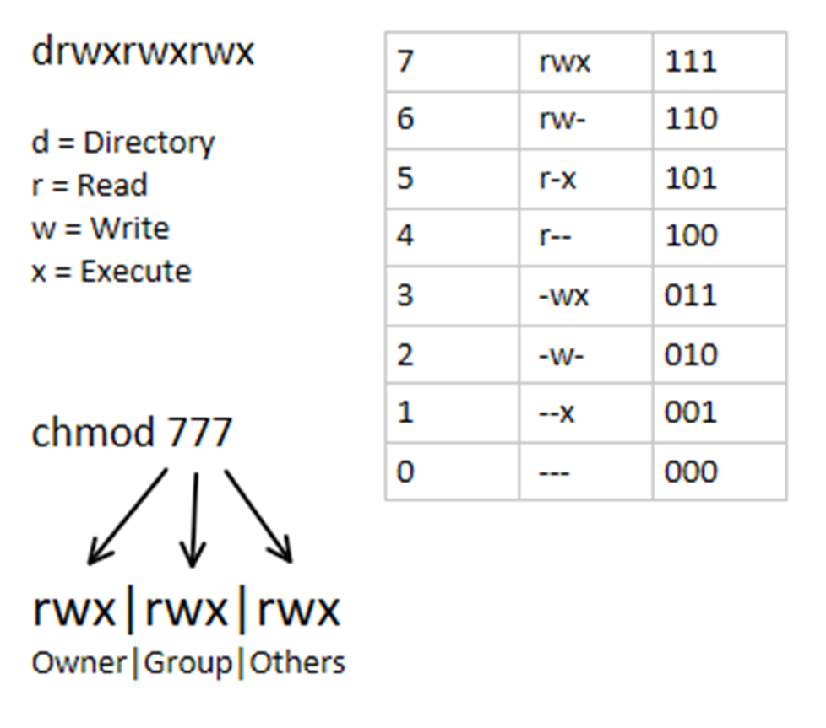
DMU HACKERS

Slide 14
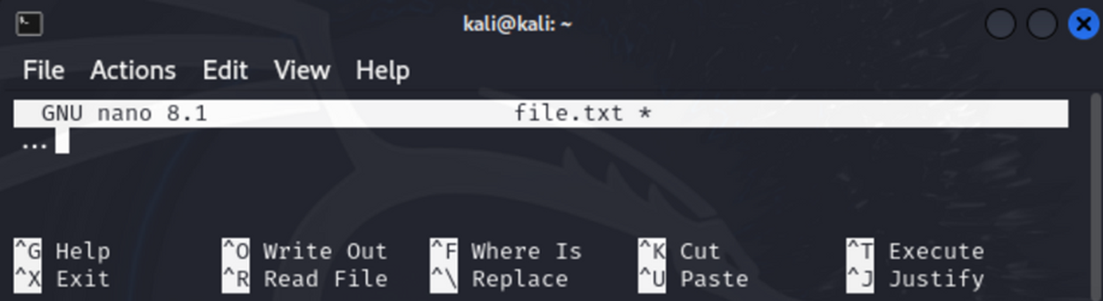
DMU HACKERS
Terminal Text Editor
nano - easiest to use, displays commands at the bottom of the screen
vim - based on vi (vi IMproved)
vi - to exit, press escape, type ‘ :q! ’ and press enter

Slide 15
DMU HACKERS
Installing Application
sudo apt update
sudo apt full-upgrade
sudo apt install <package_name>
git clone <url>

Slide 16
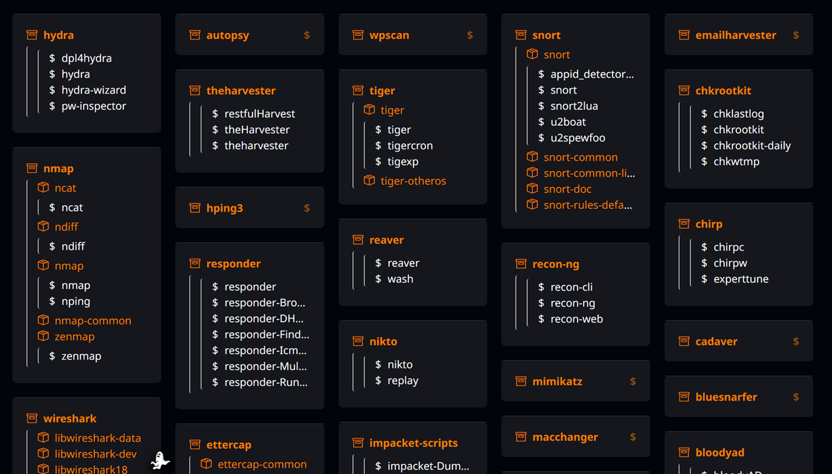
DMU HACKERS
Pre-Installed Packages
https://www.kali.org/tools/

Slide 17
DMU HACKERS
Piping and redirection
Using ( | ) - chain multiple commands
example - command 1 | command 2 | command 3
Used to chain related commands
Uses the output of one command as the input for the next
redirection - used similarly
> - inputs the output of a command to given file
< - inputs the content of a file into a command

Slide 18
DMU HACKERS
Random Tips
Passwords are not shown
Copy - ctrl+shift+c
paste - ctrl+shift+v
To interrupt a process - ctrl+c
sudo -l lists all sudo privileges the current user has

Slide 19

Practical
https://tryhackme.com/room/linuxstrengthtraining

